Slide 1
HOW TO CONVERT FROM INLINE CSS TO INTERNAL CSS

Slide 2
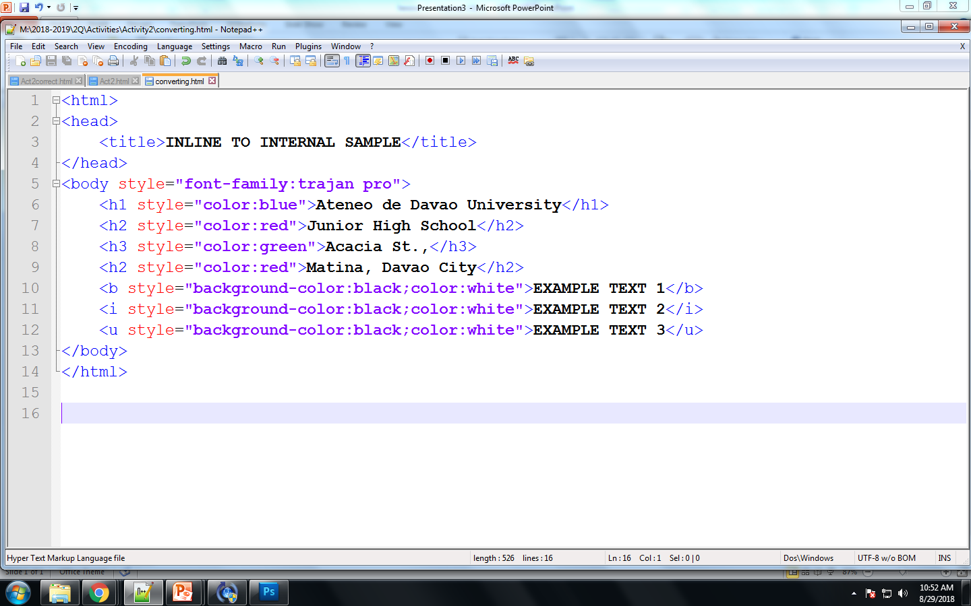
STEP 1: Check which tags have INLINE CSS
The tags with inline CSS are body, h1,h2,h3,b,i,u
Check if all instances of these tags have same styles
Note: b,i,u have the same styles

Slide 3
STEP 2: Determine the selectors
The selectors will be the names of tags with inline CSS.
They are body, h1,h2,h3,b,i,u

Slide 4
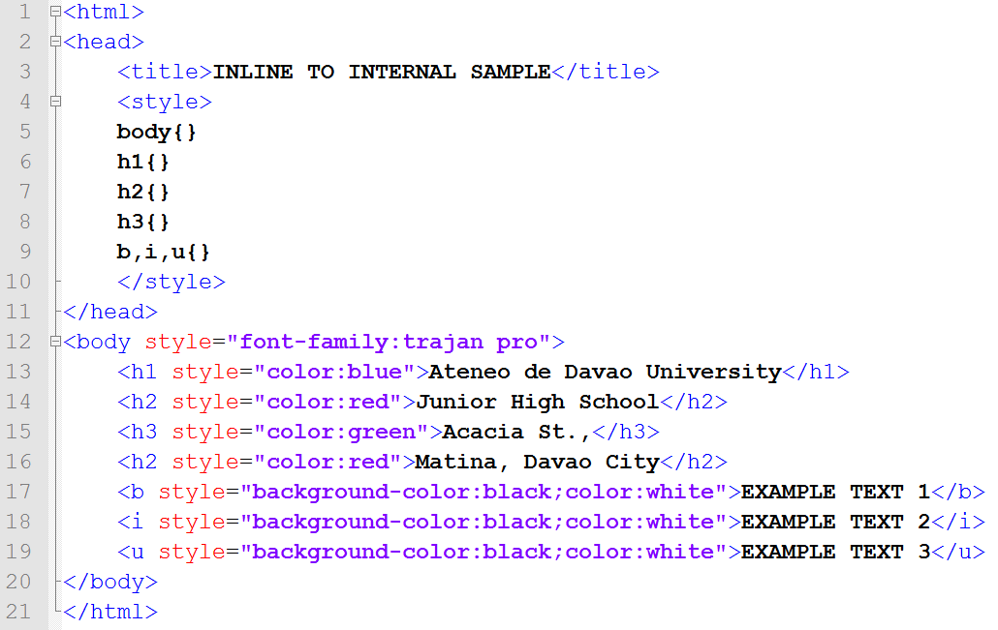
STEP 3: In the <head> tag, add the <style> tags and selectors
Note: Since b,i,u have the same styles, you can group them.

Slide 5
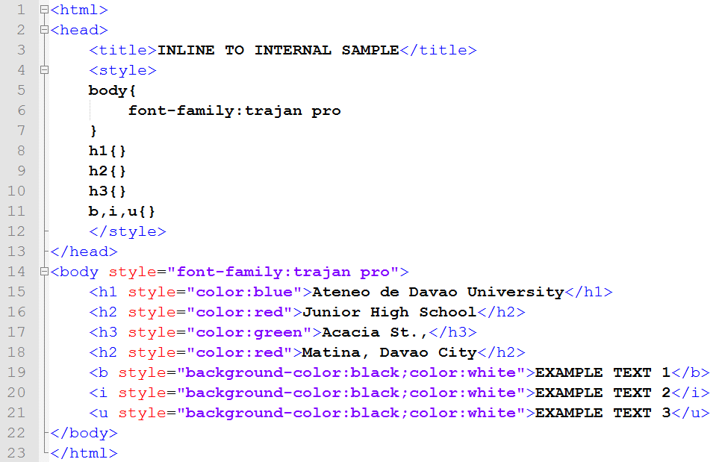
STEP 4: Transfer the styles to each selector
Copy the contents of the quotation marks in the inline CSS
Paste it inside the selector’s brackets {}
Delete the style from the tag

Slide 6
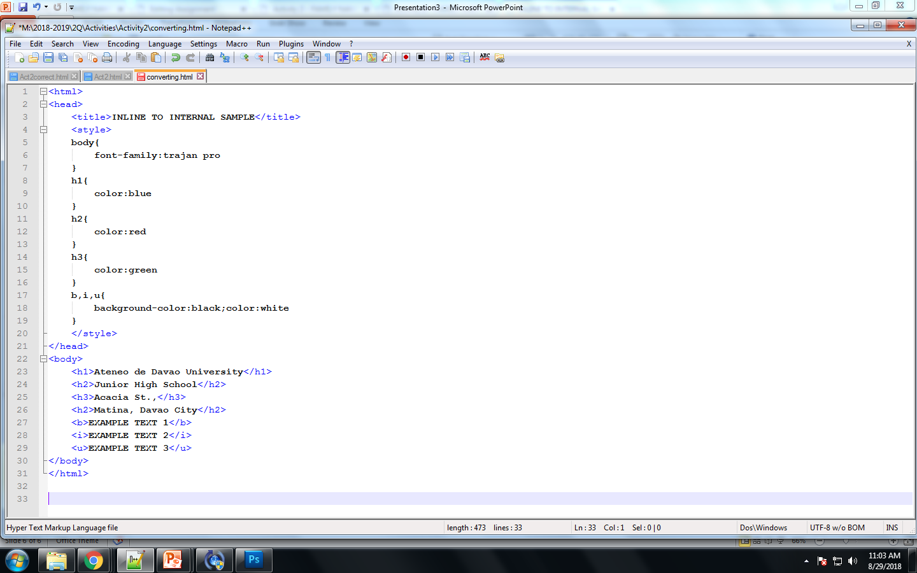
STEP 5: There should be no more INLINE CSS within the body tags

Slide 7
The output should still be the same.
DONE.

